Slide 1

Learn. Imagine. Build. .NET Conf
Build, Test, Distribute, and Monitor Xamarin apps with Visual Studio Mobile Center
Scott Densmore
Engineering Manager
Blanca Delgado Parra
Program Manager

Slide 2
Today’s Agenda
Why Visual Studio Mobile Center?
Continuous integration and deployment (CI/CD) pipeline (build, test, distribution)
Monitoring your app (analytics, crash reporting, push notifications)

Slide 3
Mobile development challenges
100+ apps
Design & Develop
1000+ devices
App delivery lifecycle
Monitor
Test
Business demands
(rapidly release high quality apps)
Multi-stage development (each app involves many stages)
Complex ecosystem (multiple devices & OS matrix)

Slide 4
Live Update
Crash Reporting
Storage
Push Notifications
Identity
Tables

Slide 5
Push Notifications
Visual Studio Mobile Center
Mission control for mobile apps
Crash Reporting
Tables
Live Update
Identity
Storage

Slide 6
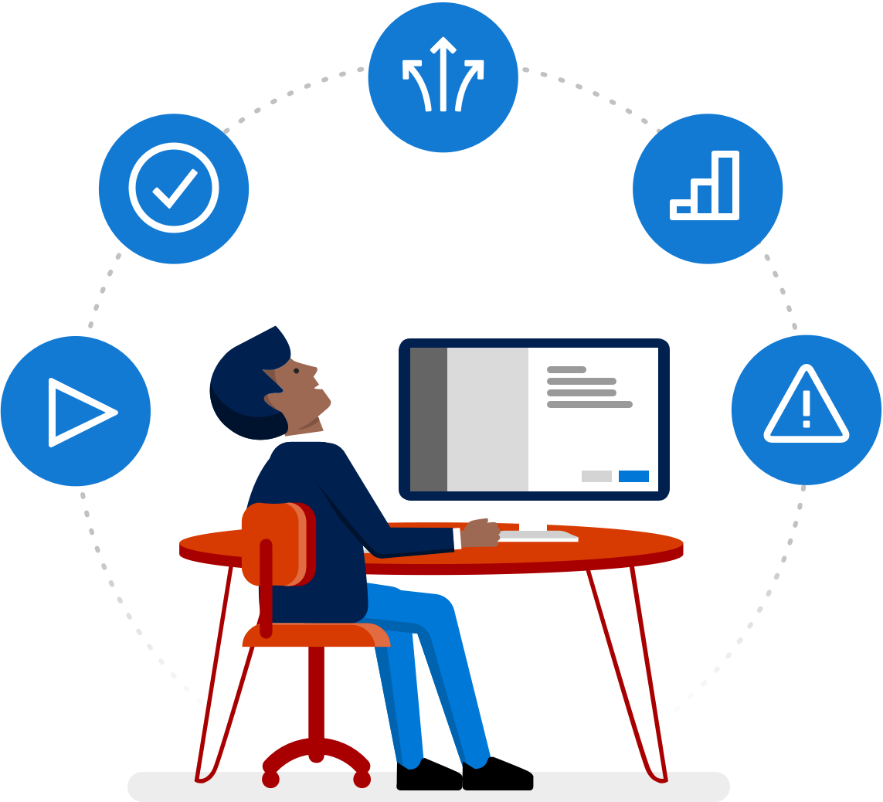
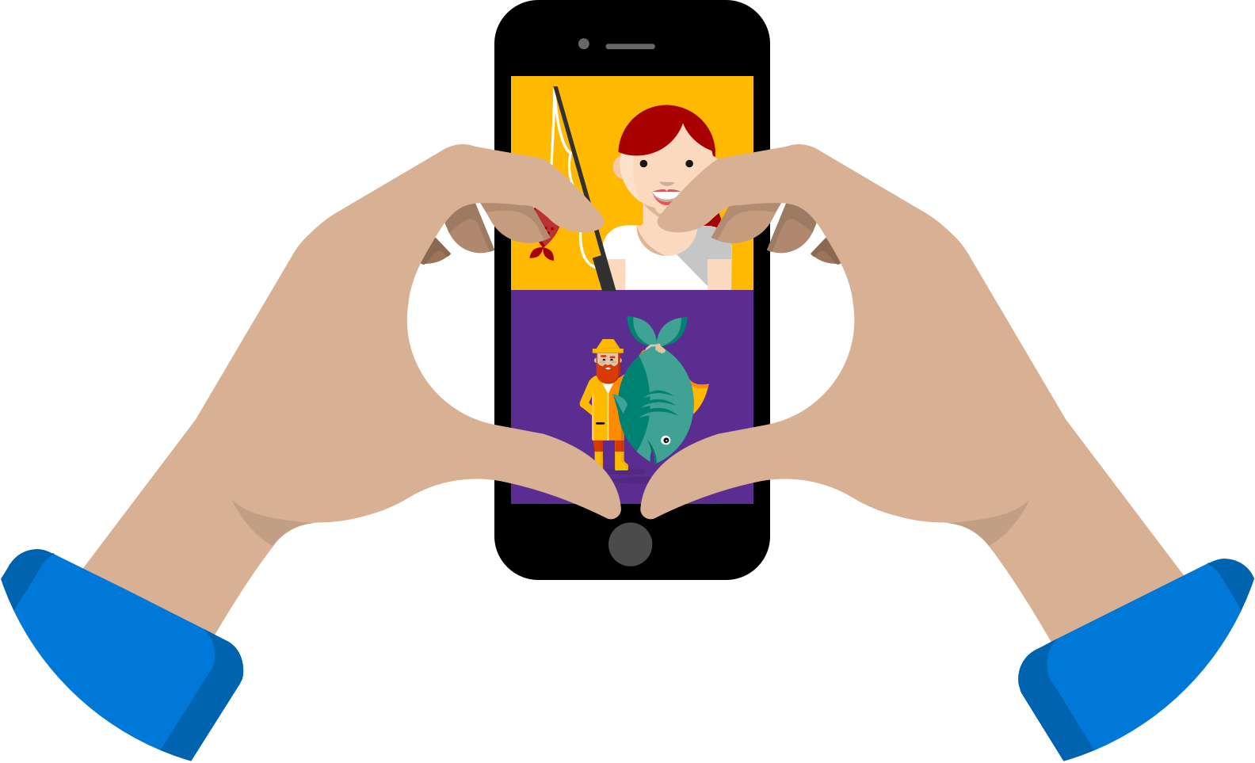
Mobile Center Objectives
Continuous everything
Build five star apps
Retain Flexibility and Choice

Slide 7







HockeyApp
Xamarin Test Cloud
Xamarin Insights
Distribute • Crashes • Analytics
Device Tests
Crashes • Analytics
Visual Studio Mobile Center
Azure Mobile Engagement
Azure App Service
CodePush
Analytics • Push
Tables • Auth • Push
Distribution
Notes:
I will talk here about how the Xamarin services came to be / and the other ones as well.
Then talk about them coming together.

Slide 8
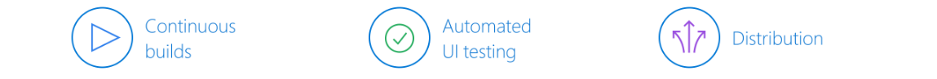
Continuous Integration and deployment
Build your apps automatically
Just point Mobile Center at your code and it will automatically build your code, on every commit.
Test on thousands of real devices
Find bugs before you ship. Automatically test your app on every commit against the same devices your users use.
Personal app store for testing
Easily distribute your beta versions to your testers with every build. Keep your users updated and your beta apps in one place.

Slide 9
Demo: CI/CD Pipeline

Slide 10
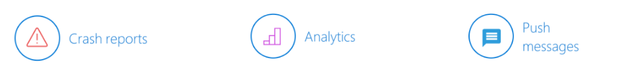
Monitoring Services
Crashes happen. Be ready when they do
When crashes happen, you need to have fast and precise information about what went wrong and why.
Insights your users won’t tell you
Simply add the SDK and get a better understanding of your audience across devices and usage. Easily create custom events to track what you need to.
Engage your users by sending them targeted messages
Send targeted push notifications to your users based on a set of device and custom properties.

Slide 11
Demo: Monitor your app

Slide 12
Session Resources
Try out Mobile Center for free while in preview
https://mobile.azure.com
Documentation and APIs
https://docs.mobile.azure.com
Future Roadmap
https://docs.mobile.azure.com/roadmap

Slide 13
Connect with us
Support center
Integrated in our portal
Follow our blog
https://engineering.mobile.azure.com
Twitter
@MobileCenter

Slide 14
.NET

